Slide 1

SMART WASTE MANAGEMENT

Slide 2
2310030419-K.Hema Charan Reddy 2310030441-M.Nihar Reddy 2310030232-Udit Raj Kumar 2310030444-K.Dheeraj
TEAM MEMBERS

Slide 3
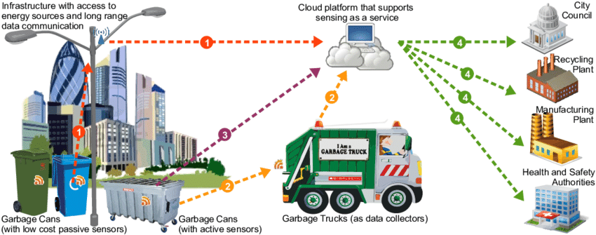
Problem Statement
Design and implement a Smart Waste Management System using advanced object-oriented programming principles in Java. The system will assist municipalities and communities in managing waste collection more efficiently

Slide 4
SOLUTION
We are developing a smart waste management platform tailored for government agencies and municipalities to efficiently manage waste in their areas. Our platform is designed to ensure a seamless and user-friendly experience, with three primary roles:
Administrator
Manages the entire system, including assigning tasks, monitoring waste collection schedules, and overseeing platform operations.
Driver
Updates the status of waste collection in real time, ensuring accurate records and efficient route management.
User
Reports issues such as overflowing bins, illegal dumping, or other waste-related concerns, helping keep the community clean and well-maintained.

Slide 5
Social Benefits
Reduces Overflowing Bins: Promotes cleaner streets and prevents environmental hazards.
Efficient Resource Allocation: Optimizes routes, saving fuel and reducing emissions.
User Engagement: Allows citizens to report issues, fostering community participation

Slide 6
THANK YOU!!

